Slide 1
Laser Fusion

Slide 2
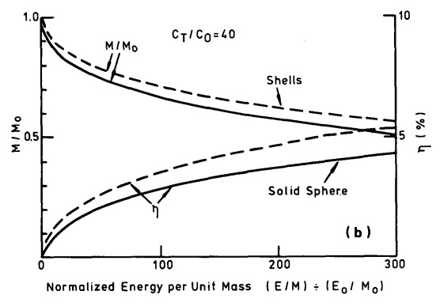
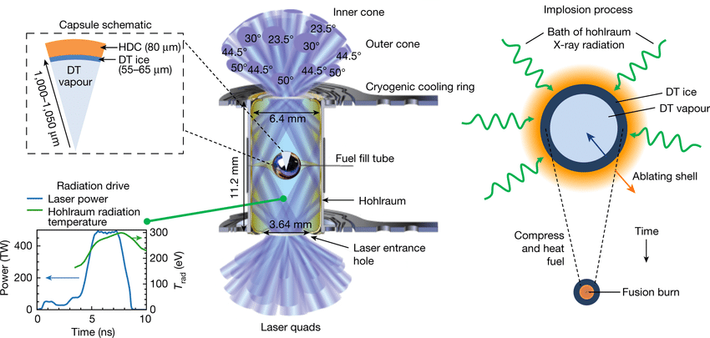
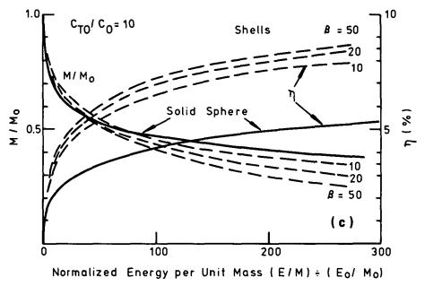
Inertial Confinement Fusion
1960: Ruby Laser
1970s: Laser Compression
1976: Ablation Studies
Laser-Plasma Interactions
[1] https://iopscience.iop.org/article/10.1088/0029-5515/16/2/005/pdf [2] https://www.nature.com/articles/s41586-021-04281-w [3] https://ui.adsabs.harvard.edu/abs/1989LPB.....7..443P/abstract

Slide 3
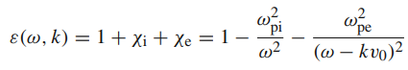
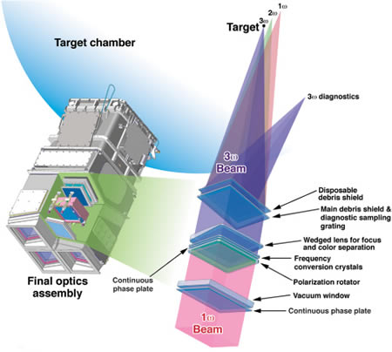
Laser Specifications
Prevent motion of pellet
Short time frame
Intense burst of energy
Isotropic distribution
High frequency
Infrared generates suprathermal electrons, which excites the fusion pellets too early
NIF lasers are 1053 nm (IR), but uses KDP HHG to get to 351 nm (UV)
[4] https://www.nature.com/articles/s41467-019-12008-9
[5] https://lasers.llnl.gov/about/how-nif-works/final-optics

Slide 4
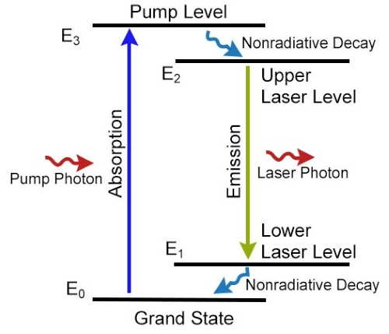
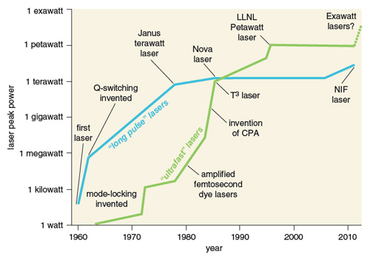
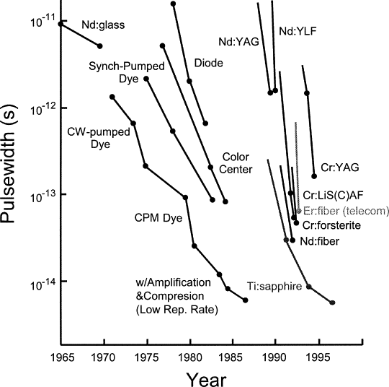
“Short” Time Frame
Only require picosecond pulse widths
[6] https://www.gophotonics.com/community/what-are-nd-glass-lasers
[7] https://www.sciencedirect.com/science/article/pii/B0122274105003732
[8] https://www.americanscientist.org/article/high-power-lasers

Slide 5
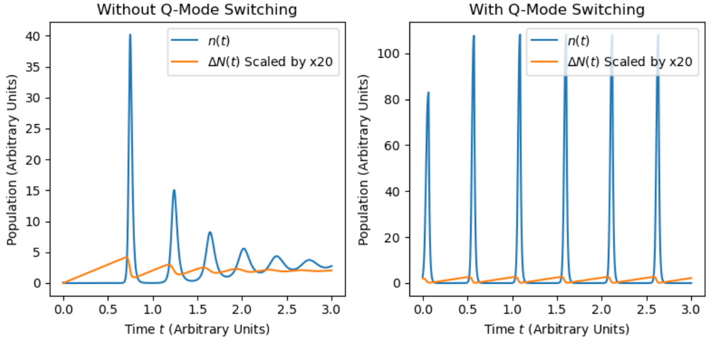
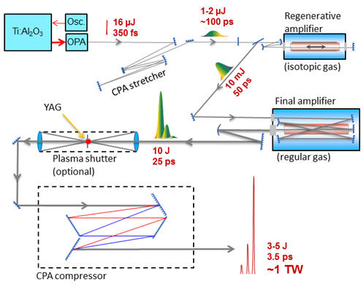
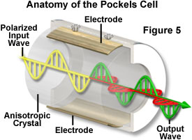
Q Switching
Generated by Pockels cell in NIF
Can be used to stop laser signals through laser-plasma interactions
[9] https://www.olympus-lifescience.com/en/microscope-resource/primer/java/pockelscell/ [10] https://www.bnl.gov/atf/capabilities/co2laser.php

Slide 6
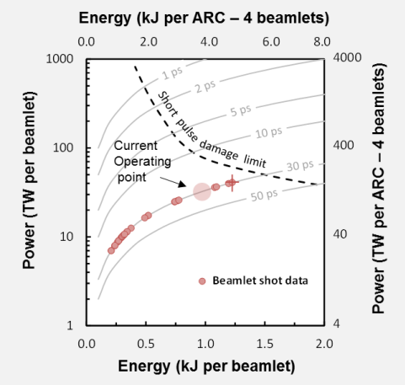
High Energy
Flash lamps directed at Nd-doped phosphate slabs provide high gain
Chirped pulse
Picosecond initial pulse
Distribute intensity in time and frequency
Lower intensity permits lower damage limits to optical components
Pulse compressor (diffraction gratings) recombine pulse
[11] https://www.osti.gov/servlets/purl/1343818

Slide 7
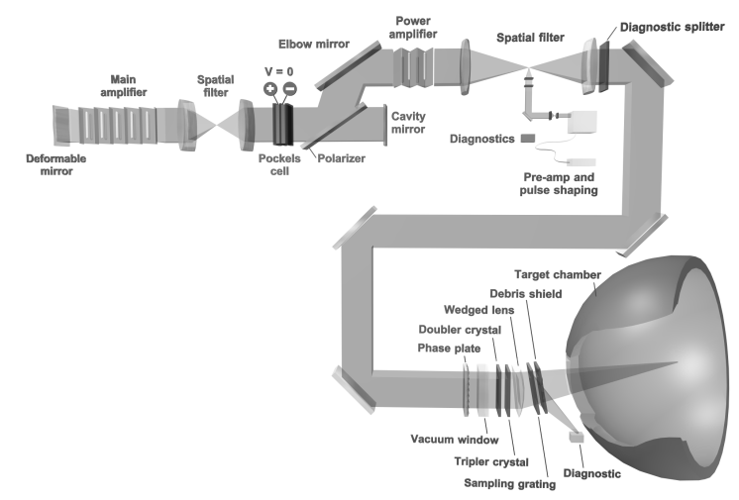
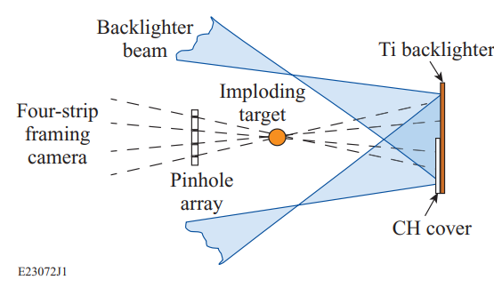
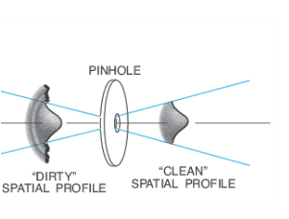
Other Components
Double/tripler crystals
Flash lamp amplifiers
PEPC control gate
Spatial filter
Diagnostics
[12] https://lasers.llnl.gov/about/how-nif-works/amplifiers
[13] https://www.osti.gov/servlets/purl/15007302
[14] https://www.newport.com/n/spatial-filters
[15] https://lasers.llnl.gov/science/photon-science/arc
[16] https://pubmed.ncbi.nlm.nih.gov/25430361/
[17] https://pubs.aip.org/aip/pop/article/22/11/110501/109006/Direct-drive-inertial-confinement-fusion-A-review

Slide 8

Questions?

